Slide 1
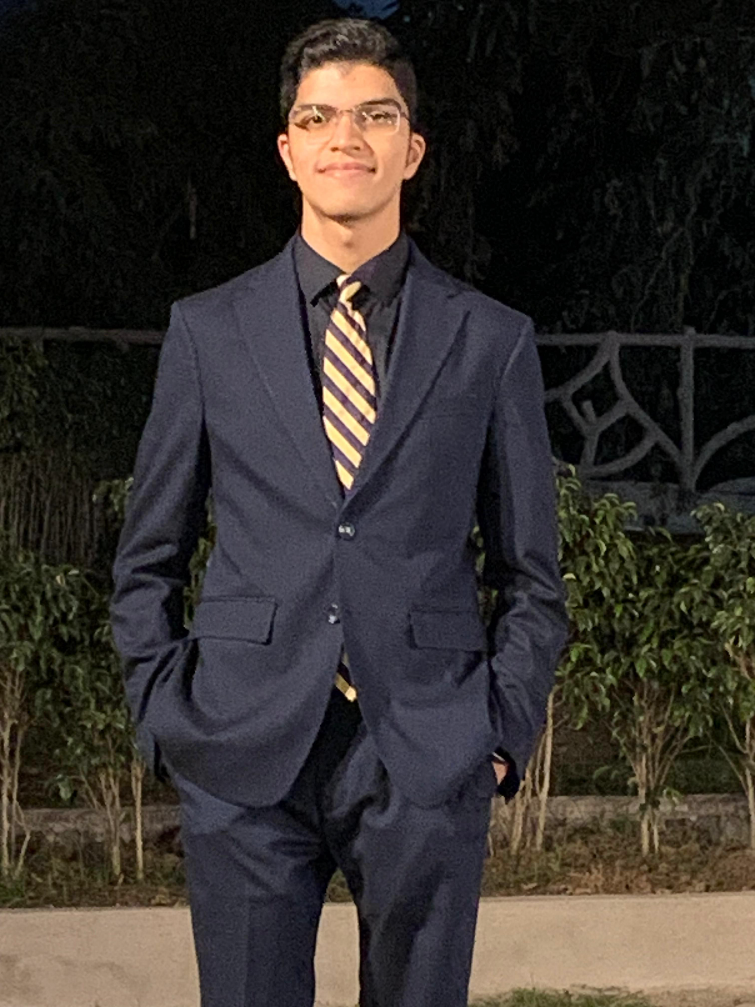
A.N.S.H.U.L – A virtual assistant.
PRESENTED BY
STUDENT NAME: ANSHUL KUMARIA
COLLEGE NAME: DR. VISHWANATH KARAD MIT WORLD PEACE UNIVERSITY
DEPARTMENT: B.TECH (COMPUTER SCIENCE AND ENGINEERING) - CORE
EMAIL ID: anshul.kumaria@mitwpu.edu.in
AICTE STUDENT ID:
STU67ea22231cb0b1743397411

Slide 2

OUTLINE
Problem Statement
Proposed System/Solution
System Development Approach
Algorithm & Deployment
Result (Output Image)
Conclusion
Future Scope
References

Slide 3
PROBLEM STATEMENT
This project, titled A Nice Sophisticated Helpful Unique Listener (A.N.S.H.U.L.), explores
the automation of routine and non-essential tasks using the Python programming language.
A.N.S.H.U.L. is a voice-activated assistant that leverages speech recognition and task
automation to streamline various activities, thereby conserving user energy and effort.
The assistant integrates Python libraries such as pyttsx3 for text-to-speech, speech_recognition
for voice input processing, webbrowser for automated internet navigation, and pywhatkit for
additional functionality such as WhatsApp message scheduling. This demonstrates Python’s
utility in creating accessible, real-time systems capable of precise execution with minimal
hardware requirements.

Slide 4
PROPOSED SOLUTION
A.N.S.H.U.L. is specifically tailored for personalized interaction, implementing speech-based commands to
execute everyday tasks such as sending messages, retrieving information from the web,
providing time and date updates, and launching web-based media. By offering an interactive
platform that executes predefined commands with minimal user input, the system addresses the
necessity for intuitive, hands-free task management in a wide range of personal and professional
settings.
A.N.S.H.U.L. leverages libraries such as speech_recognition for command acquisition, pyttsx3 for auditory feedback, and pywhatkit for enhanced functionality, including real-time message delivery over social platforms. These libraries not only facilitate the rapid development of a modular architecture but also allow for scalable integration with additional features in future iterations. Python's light
hardware requirements make it particularly suitable for real-time systems, allowing A.N.S.H.U.L. to function efficiently across varied computational environments, from personal computers to embedded systems.
The conceptual basis of A.N.S.H.U.L. lies in task automation. By automating routine operations, the system demonstrates how simple commands can be transformed into complex interactions, which are executed in real-time with minimal latency. This project, therefore, contributes to ongoing research in personal automation systems, highlighting Python's capacity to serve as a robust foundation for voice-driven, real-time applications. The assistant’s ability to perform a range of functions without direct manual interaction offers users both time savings and ease of access, promoting a more efficient daily routine.

Slide 5
SYSTEM APPROACH
1. Speech Recognition: The system listens for user input via microphone, utilizing the
speech_recognition library to convert spoken language into text.
2. Command Processing: Commands are processed by parsing recognized text, which then
directs the assistant to execute specific tasks.
3. Task Execution: Depending on the command, the system utilizes built-in functions, such
as sending WhatsApp messages, retrieving data from the web, playing music, or
returning to an idle state.
4. Text-to-Speech (TTS): Using the pyttsx3 library, the assistant provides feedback to the
user, enhancing the interactive experience through synthesized voice responses.

Slide 6
ALGORITHM & DEPLOYMENT
The system architecture of A.N.S.H.U.L. follows a modular design consisting of three core
components:
• Input Module: This module uses a microphone to capture and transcribe speech input.
• Processing Module: Here, the recognized text is interpreted, and corresponding
commands are matched and processed.
• Output Module: Responsible for both task execution and auditory feedback, this module
returns the results of executed commands to the user via text-to-speech responses or
visual feedback.
The system operates in a loop where each module is invoked in sequence, allowing for
continuous command recognition and task execution.

Slide 7
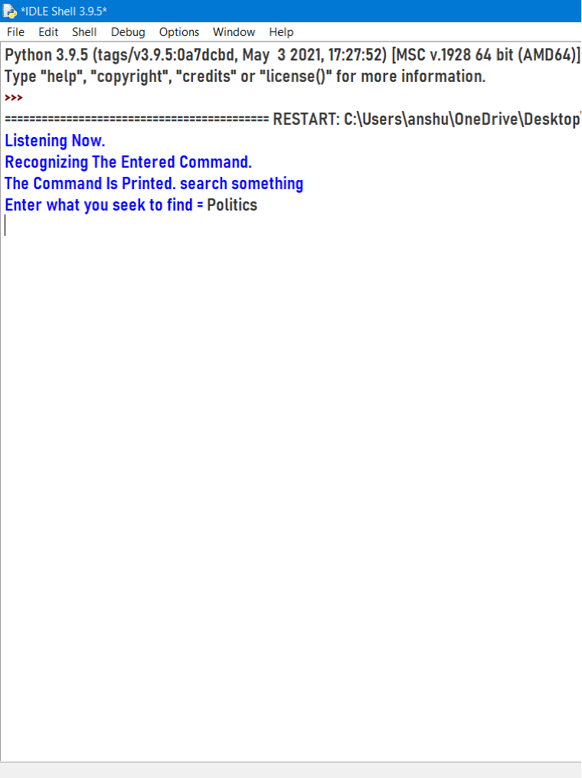
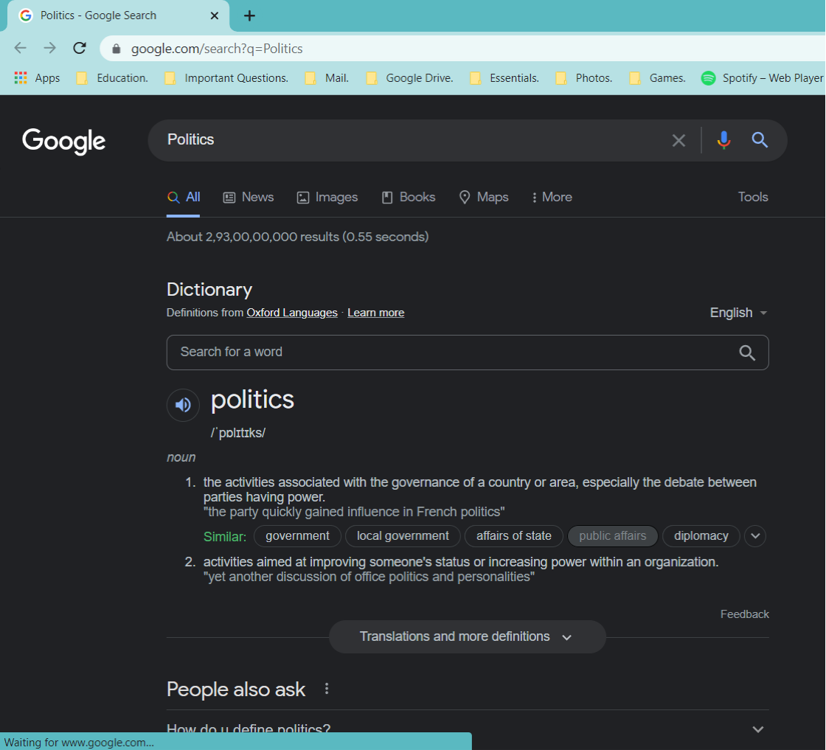
RESULT

Slide 8
CONCLUSION
A.N.S.H.U.L. highlights Python’s potential in the field of task automation and real-time user
interaction. By executing routine tasks based on voice commands, A.N.S.H.U.L. provides a user friendly
solution that minimizes manual input, enabling a more efficient workflow. The system
underscores the viability of Python for building robust, interactive task managers that are both
resource-efficient and highly functional.

Slide 9
FUTURE SCOPE
Future work on A.N.S.H.U.L. could focus on:
• Enhanced Speech Recognition: Integrating noise-cancellation algorithms to improve
recognition in diverse environments.
• Machine Learning Integration: Adding a learning layer to adapt responses based on
user preferences.
• Smart Home Integration: Extending functionality to include IOT device control, thereby
transforming A.N.S.H.U.L. into a smart home assistant.

Slide 10
REFERENCES
https://pyttsx3.readthedocs.io/en/latest/
https://github.com/Ankit404butfound/PyWhatKit
https://docs.python.org/3/library/webbrowser.html
https://matplotlib.org/stable/gallery/lines_bars_and_markers/bar_label_demo.html
https://pyttsx3.readthedocs.io/en/latest/

Slide 11
Thank you

